Slide 1
Supermarket Automation Software (SAS)
Group Number: 33
The Odd One Out
Kaushal Banthia (19CS10039)
Shashwat Shukla (19CS10056)
Parth Tusham (19CS30034)

Slide 2
Problem Description
Develop a supermarket software.
The supermarket stocks a set of items.
Customers pick up their desired items from the in required quantities. The customers present these items to the sales-clerk.
The sales-clerk registers the items in the software and then after adding all the quantities to the cart generates the Bill, and the transaction gets recorded.
The manager can view the various transaction and can manage the clerks and the inventory.

Slide 3
Problem Specification and Users Involved
Manager:
Edit Users
Edit Inventory
Add Product
Create Report
Clerk:
Transaction
View Inventory

Slide 4






Technologies Used
Backend: Python, Django
Frontend: HTML, CSS, Bootstrap, Javascript (chart.js)
Database: SQLite

Slide 5
Why Python and Django?
Python is a high-level programming language, which has the support for full stack development, via powerful frameworks such as Django.
Also, Python is an Object-Oriented Language, which makes the Abstraction of the Problem simpler, as we are able to relate it with real life entities.
Also, Django provides us with many built in functionalities like Login, Register User (which are already heavily tested beforehand, and thus make the software the more Robust).
Django also provides easy and robust database management, via models (which is class based and uses SQLite).

Slide 6

Challenging Use Cases
Need to manually install a .DLL file for using JSONField (only for Windows).
Link for Solution
chart.js: The first choice to plot graphs was obviously the Matplotlib library. But after a bit of thinking, we chanced upon chart.js, which is more interactive and robust.

Slide 7

Future Improvements
Implementation of a Payment Gateway
Security:
HTTPS instead of HTTP should be used
DDOS Prevention
Distribution through Docker
Hosting the Database Through AWS / Azure for faster use

Slide 8
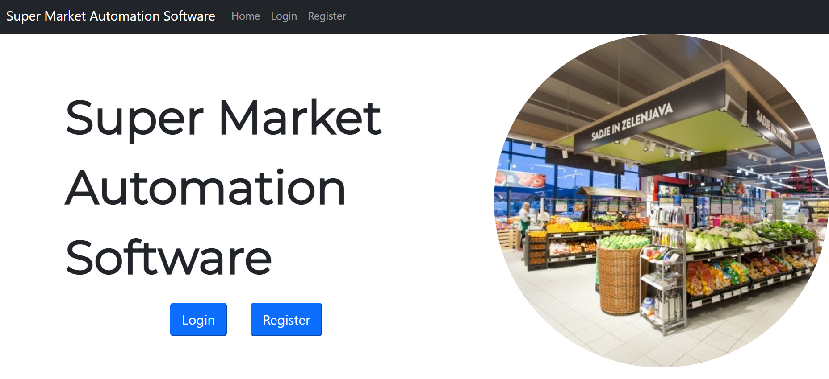

Slide 9
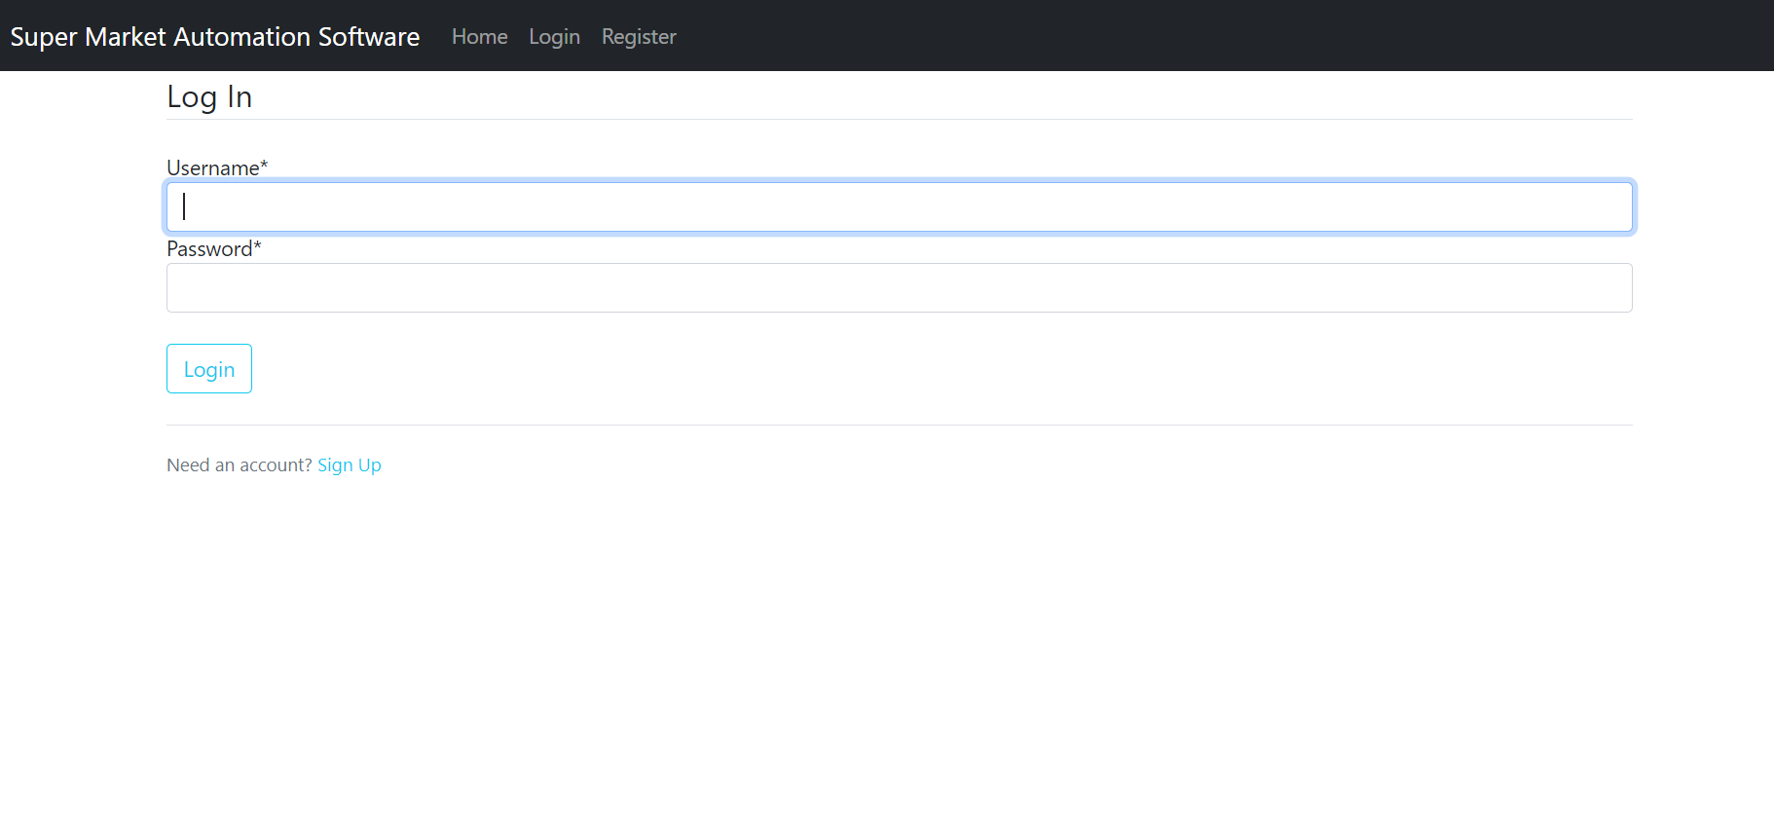

Slide 10
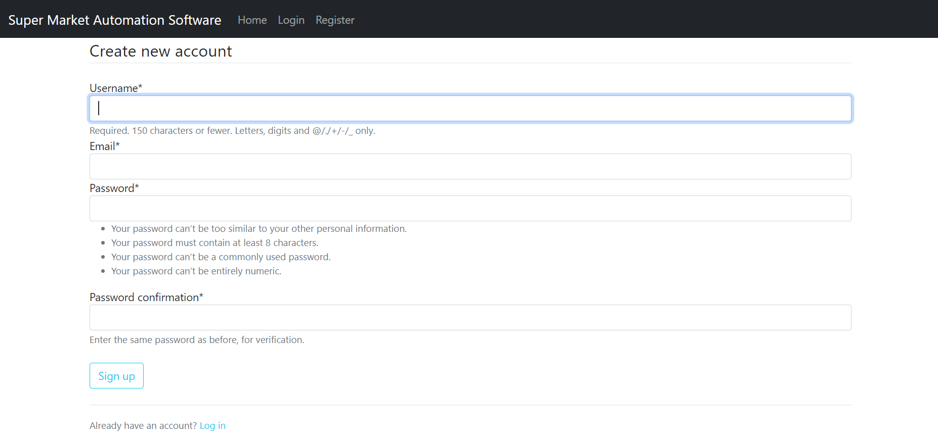

Slide 11
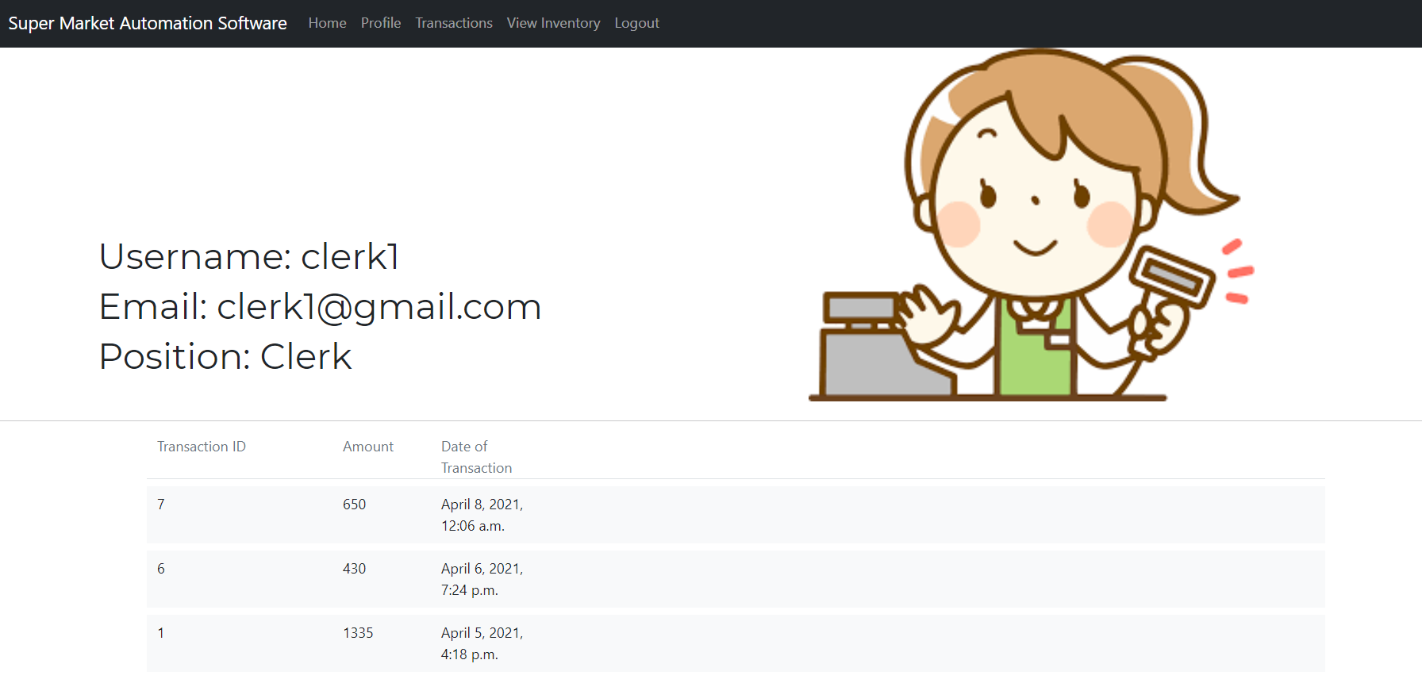

Slide 12
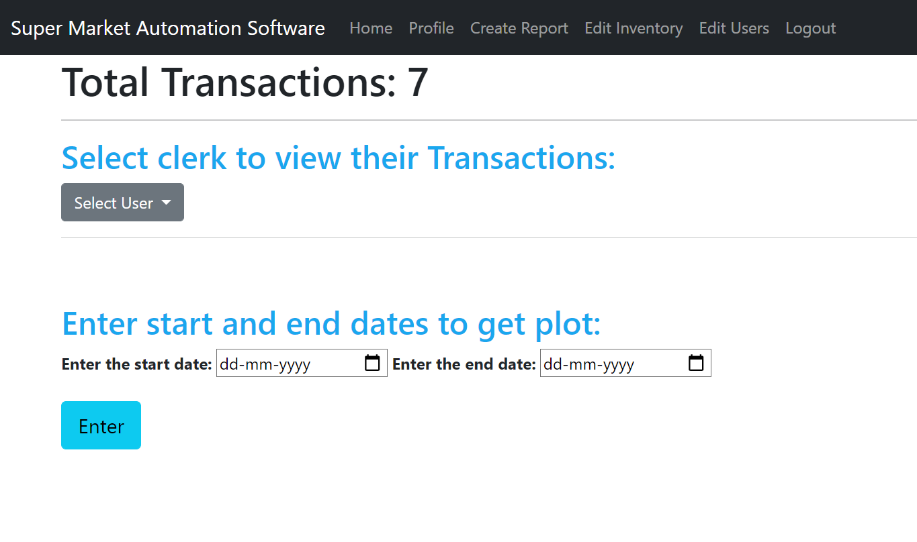

Slide 13
